Slide 1

LEADING CHANGE

Slide 2
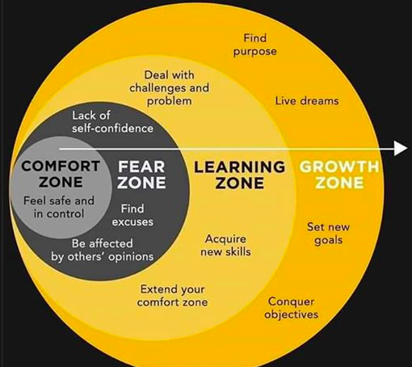
WHY IS THIS SO HARD?

Slide 3
CHANGING FROM……..TO…….
CHURCH IS FOR US
PASTOR IS TO SHEPHERD
ACCOUNTABLE TO PEOPLE
SAFETY OF STATUS QUO
CHURCH IS FOR THEM & us
PASTOR TO LEAD & shepherd
ACCOUNTABLE TO MISSION
SAFE PLACE IS NOT SAFE

Slide 4
LEADING CHANGE: 6 MYTHS

Slide 5

Myth #1 Crisis is a powerful impetus for change
REALITY
90% of patients who have had coronary bypass don’t sustain changes in the resolutions they make that could changes their lives.

Slide 6
Myth #2 Change is motivated by fear
REALITY
Most of us go into denial about the bad things that will happen to us. A compelling positive vision of the future is a much stronger motivation for change.

Slide 7

Myth #3 The truth will set us free
REALITY
Our thinking is guided more by stories than by data. When a fact does not fit our desires we find a way to avoid it. Stories are not so easily dismissed.

Slide 8

Myth #4 Slow and gradual change is always easier.
REALITY
Rapid and broad change is often easier as it often yields faster benefits that reinforce new behavior.

Slide 9
Myth #5 We cannot change because our brains are hardwired.
REALITY
Our minds have extraordinary “plasticity”. We are capable of complex change throughout our lives if we stay active and engaged.

Slide 10
MYTH #6 RESISTANCE TO CHANGE IS REASONABLE
Vs. 18 Some seed was sown among thorns, but the worries of life…. choke it.
Reality:
Most congregations prefer
safety & comfort to the anxiety
that usually goes with change.
Their reason for resistance is
anxiety…worry…fear.
Oftentimes, LOSS is driving fear.

Slide 11
THE ANXIETY DOOM LOOP.
Need for change
Anxiety push back
Leaders cave
Leaders unprepared

Slide 12
LEADING CHANGE: FOUR KEYS

Slide 13
1. LEADING CHANGE: Build Trust
Nothing moves faster….
than the speed of trust.

Slide 14
Trust Builders
Practice total transparency
Confront reality in yourself & circumstances.
Clarify expectations of all parties.
Demonstrate accountability.
Listening before speaking.
Keeping your commitments entirely.
Focus on results not just activity.
Right whatever wrongs you must.
Humbly seek improvement and show it.
Be loyal to your commitments.

Slide 15
2. LEADING CHANGE: Clarify Values
Advancing ministry is less
about mechanics and more about
values.

Slide 16
What values will define this ministry?
treasured traditions
popular trends
God’s Mission
personal preferences
valued relationships

Slide 17
Multiplication Values
Compassion for the unchurched
Culturally relevant style
Great Commission orientation
Developing and releasing leaders
Confidence in God’s ability
Kingdom perspective
Generosity

Slide 18
3. LEADING CHANGE: Communicate Vision & Process
Advancing your ministry is more
momentum than calendar driven.

Slide 19
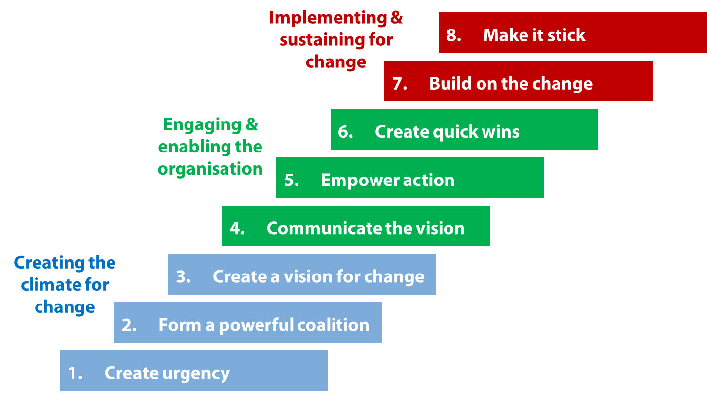
LEADING CHANGE; John Kotter

Slide 20
New Service/Site Process
10. LAUNCH MONTH CELEBRATION
9. BROAD MARKET PROMOTION 1000’s
8. 2-4 “soft” PREVIEW SERVICES 2-4
7. LAUNCH TEAM 40+ PEOPLE 40
6. FORM SMALL GROUPS 3-4
5. MISSION ENGAGEMENT 1000
4. KEY TEAM TRAINING
3. STRAT PLAN/PRAY 100
2. ORG CHANGE
1. PASTOR

Slide 21
4. LEADING CHANGE: Stay Calm
Just the time a leader decides to risk wise change,
anxiety shows up to choke it to death.

Slide 22
Sabotage Solutions:
Stay calm and clear.
Clarify key values.
Develop an internal “LEAD TEAM” of supporters.
Structure accountability to external Stake Holders

Slide 23
QUESTIONS……….?
COMMENTS……….!

Slide 24
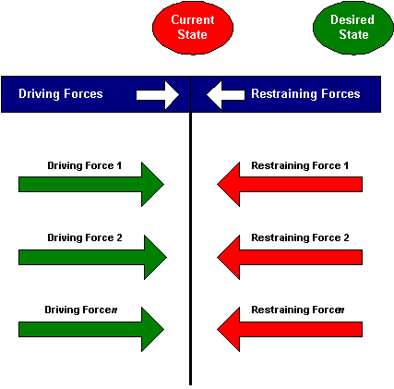
Force Field Analysis…..

Slide 25
LEADING CHANGE WILL REQUIRE….?

