Slide 1
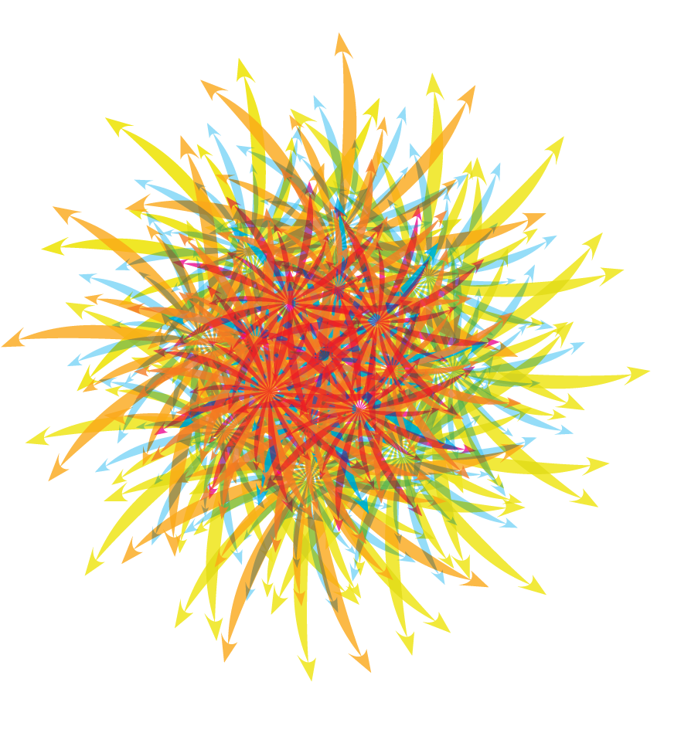
YOUR CHURCH CAN MULTIPLY
COMMUNITY ENGAGEMENT
LEADERS
CONGREGATIONS

Slide 2
WHY MULTIPLY?
The Kingdom of God… is like a mustard seed, which a man took and planted in his garden. It grew and became a tree, and the birds perched in its branches.”
Luke 13:18-19

Slide 3
MULTIPLY COMMUNITY ENGAGEMENT

Slide 4

1. Intentional Neighboring

Slide 5
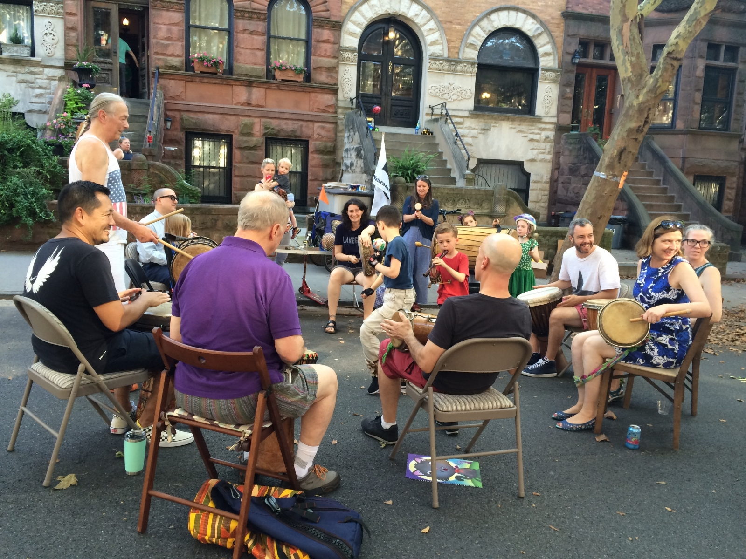
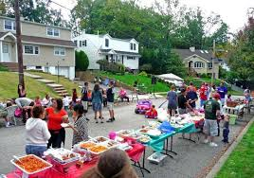
THE POWER OF THE BLOCK PARTY Stranger>Acquaintance>Friend

Slide 6

National Night Out 8/6

Slide 7
It’s all about relationships…
INTEREST GROUPS
Book club
Cycling group
Cooking group
Runners club
Gaming group
Gardening group
Fishing group
SPECIAL EVENTS
Chili cook off
5k fund raiser
Neighborhood clean up
Lego Camp
Live Nativity Scene
Fishing tournament
Kids bike tune up

Slide 8

2. Faith Based Community Education
Premarital / marriage enrichment education
Parenting education
Recovery 12 step
Career transition www.crossroadscareer.org/
Successful relationships training
ALPHA…

Slide 9

3. Business Networking Three Step Approach
a. Begin as a learner….”What have you learned about serving
people effectively in this community?”
b. Is there anything we could do to serve you?
c. Can we stay in touch?

Slide 10

4. Crowdsource Your
Programming

Slide 11


Slide 12
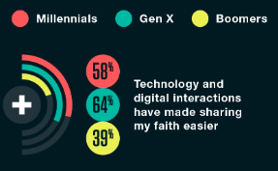
5. LEVERAGE SOCIAL PLATFORMS
SOURCE: Barna Group Spiritual Conversations in a Digital Age

Slide 13

1. IDENTIFY 3-4 key weekends
2. LAUNCH a new relevant 3-4 week teaching series on those key weekends.
3. DEVELOP SHARABLE FB CONTENT to promote your new series each weekend.
4. SHARE THE FB CONTENT with your people.
5. TRAIN YOUR PEOPLE to like/share/comment on your content with their FB friends.

Slide 14

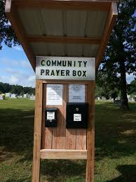
6. Free Prayer Mailbox

Slide 15
WHAT HAS WORKED FOR YOU?

Slide 17
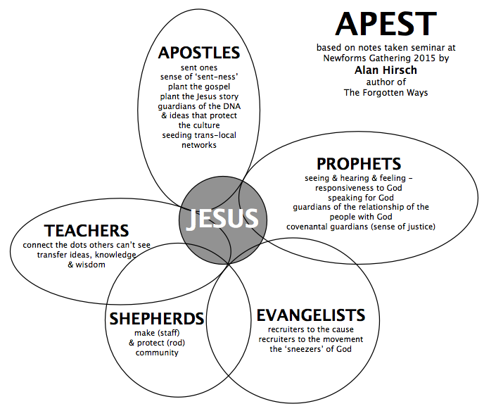
MULTIPLY LEADERS

Slide 18
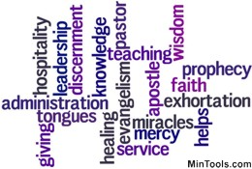

Slide 19
THE CASE OF UNLIKELY TIMOTHY
Timothy was young when Paul recruited him. Acts 16:1-3
Timothy’s father was either uninvolved in his life or had abandoned he and his mother as there is no reference to a father figure
Timothy was shy and introverted by nature. I Cor. 16:10-11

Slide 20
“The things you have heard me say in the presence of many witnesses entrust to reliable people who will also be qualified to teach others” (2 Tim. 2:2)
FIRST GENERATION: JESUS TO PAUL
SECOND GENERATION: PAUL TO TIMOTHY
THIRD GENERATION: TIMOTHY TO RELIABLE PEOPLE
FOURTH GENERATION: RELIABLE PEOPLE TO OTHERS

Slide 21

ARE YOU AN ACCIDENTAL DIMINISHER?
MULTIPLIERS ARE…
Generative vs. ownership style
Permission giving vs. withholding
Questioning/listening vs. answering/talking
OK with others failure vs. fear of failure
People development vs. program mgmt.

Slide 22
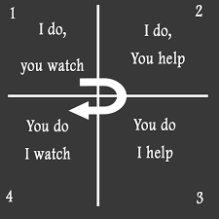
Multiplying Leaders Best Practice: Apprenticing

Slide 23
Multiplying Leaders Best Practice: Coaching
MONTHLY MEETING…reinforcing follow through.
CAREFUL LISTENING…hearing their struggles.
POWERFUL QUESTIONS…helping to see clearly the issues involved.
BRAINSTORMING OPTIONS…seeing possible solutions.
CHOOSING THE BEST OPTION…their decision to act.
ACCOUNTABILITY FOLLOW UP…a date for completion and next mtg

Slide 24


Slide 25
WHAT HAS WORKED FOR YOU?

Slide 26
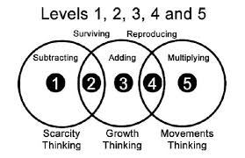
MULTIPLY CONGREGATIONS:
New Service to Reach New People

Slide 27
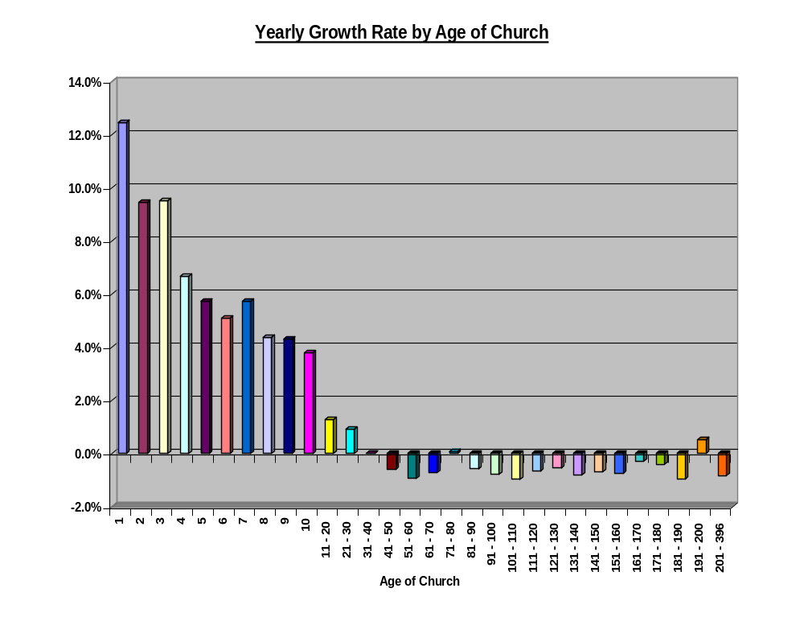
G
R
O
W
T
H
o
f
C
H
U
R
C
H
AGE of CHURCH
SOURCE: The American Church research, 75,000 evangelical & mainline protestant churches

Slide 28
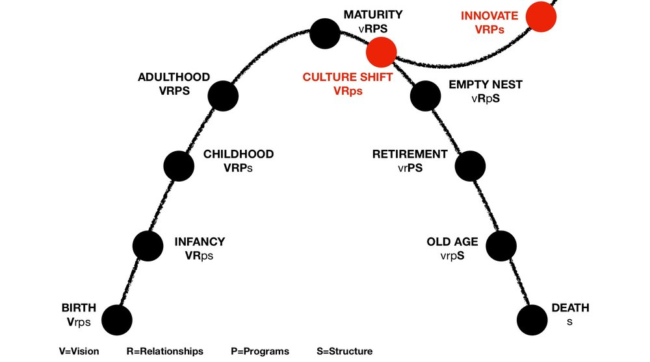

Slide 29

MULTIPLICATION VALUES
COMPASSION FOR THE UNCHURCHED
GREAT COMMISSION ORIENTATION
DEVELOPING / RELEASING LEADERS
CULTURALLY RELEVANT STYLE
KINGDOM PERSPECTIVE
CONFIDENCE IN GOD
GENEROSITY
>
https://www.minnesotaumc.org/resourcesforparentchurchleaders

Slide 30
WHAT IS AT THE CENTER?
treasured traditions
ecclesial systems
God’s Mission
personal preferences
valued relationships

Slide 31
Multiplication Risk/Reward Continuum
Second service on campus
Second service off campus
Multi site with single teacher
Multi site w/ X teachers
New Church plant
←--------------------------------------------------------------------→
multiplying disciples, leaders & ministries

Slide 32
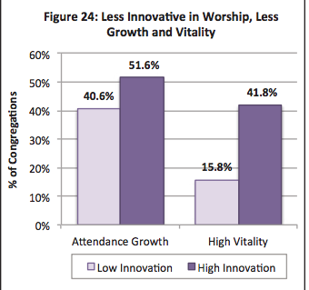
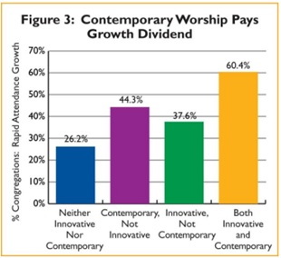
Source: FACT Report 2015 faithcommunitiestoday.org

Slide 33
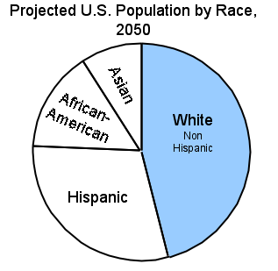
OUR CHURCH DECLINE NARRATIVE
VS.
THE 2042 IMMIGRATION NARRATIVE.
IMMIGRANTS DO NOT RELATE TO
OUR DECLINE NARRATIVE.

Slide 34
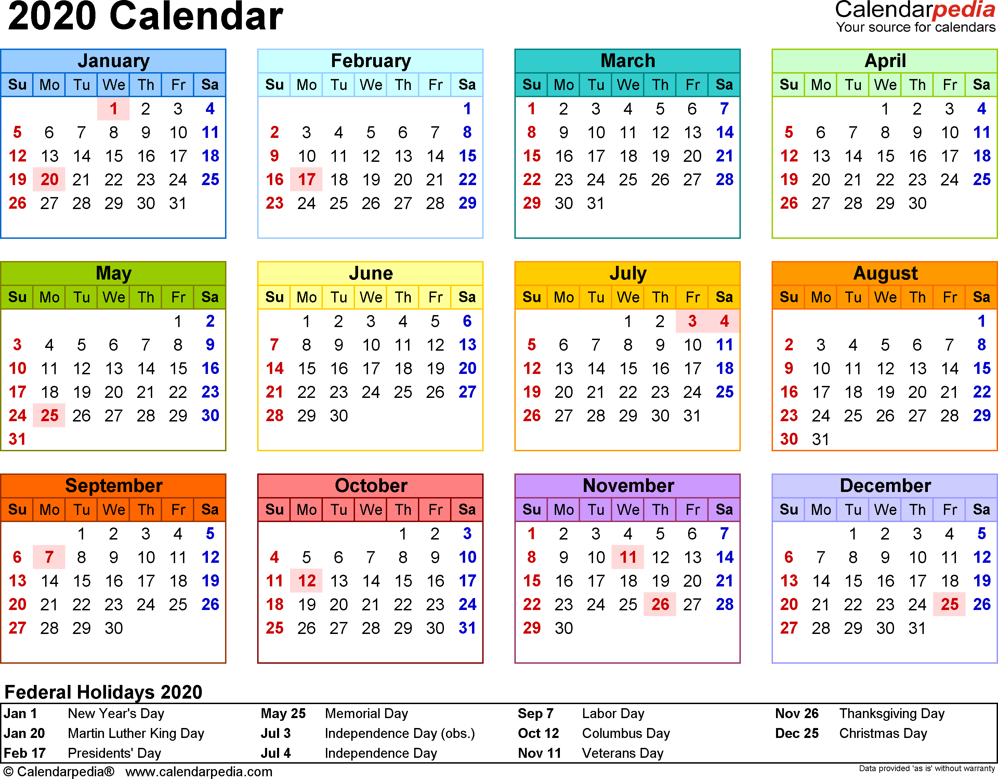
Five Phases….12 months + training + coaching
FOUNDATIONS Months 1-3
COMMUNITY ENGAGEMENT Months 3-12
BUILDING STRUCTURE Months 6-12
PREPARING WORSHIP Months 9-11
LAUNCHING WORSHIP Month 12

Slide 35
NEXT STEPS…..
MINNEAPOLIS INCUBATOR
SEPTEMBER 24-25
CONTACT TO REGISTER: Gail Johnson
Gail.Johnson@minnesotaumc.org

