Slide 1
LARGE LAUNCH ESSENTIALS

Slide 2
each one should build with care. ¹¹ For no one can lay any foundation other than the one already laid, which is . I Cor. 3: 5ff What, after all, is Apollos? And what is Paul? Only servants, through whom you came to believe—as the Lord has assigned to each his task. ⁶ I planted the seed, Apollos watered it, but God has been making it grow. ⁷ So neither the one who plants nor the one who waters is anything, but only God, who makes things grow. ⁸ The one who plants and the one who waters have one purpose, and they will each be rewarded according to their own labor. ⁹ For we are co-workers in God’s service; you are God’s field, God’s building.
¹⁰ By the grace God has given me, I laid a foundation as a wise builder, and someone else is building on it. But each one should build with care. ¹¹ For no one can lay any foundation other than the one already laid, which is Jesus Christ.

Slide 3
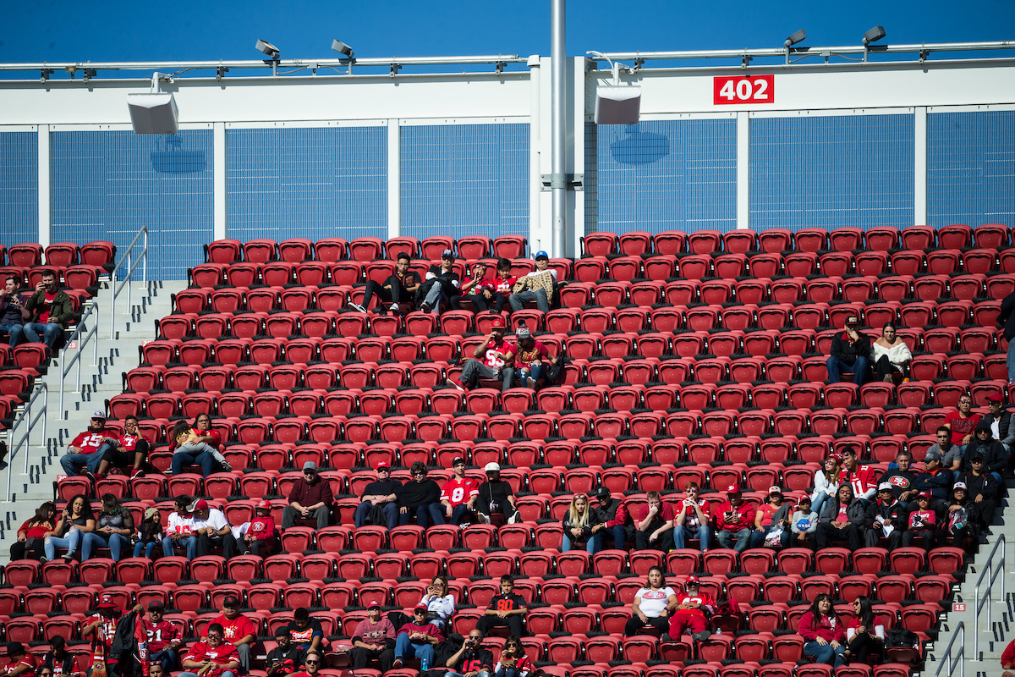

Slide 4
WHY LAUNCH LARGE?
Launch small and new attenders likely feel the “cringe” factor and will not return.
Launch small and people form a “small church” mental map predicting you stay small.
Launch small and you are caught in the double bind of having to produce weekend services plus network and promote at a high rate.
Launch small and you will likely re-launch which is costly and sends a message to your team that you did not prepare well.
Launch small and you cannot grow fast enough to survive.

Slide 5
PRIMARY METRICS IN A LARGE LAUNCH
1000 or more community contacts…..you are known widely.
40 or more committed disciples…..you have many inviters and disciplemakers.
7 or more key leaders…..you have essential leaders of teams.
4 or more small groups….you have a “go to” & “come back” assimilation and discipleship strategy.
3 or more pre-view services….you build momentum and readiness before launch

Slide 6

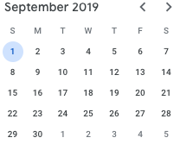
MOMENTUM DRIVEN vs. CALENDAR DRIVEN

Slide 7
1. 1000 or More Community Contacts
a. A contact is someone you share the vision with and are able to . communicate with later through FB, email, text or phone.
Contacts should be ranked as: core/ contact/ committed/collaborator/connected.
Contacts should be developed into a communication plan, prayed for individually and cultivated for the launch and well beyond.

Slide 8
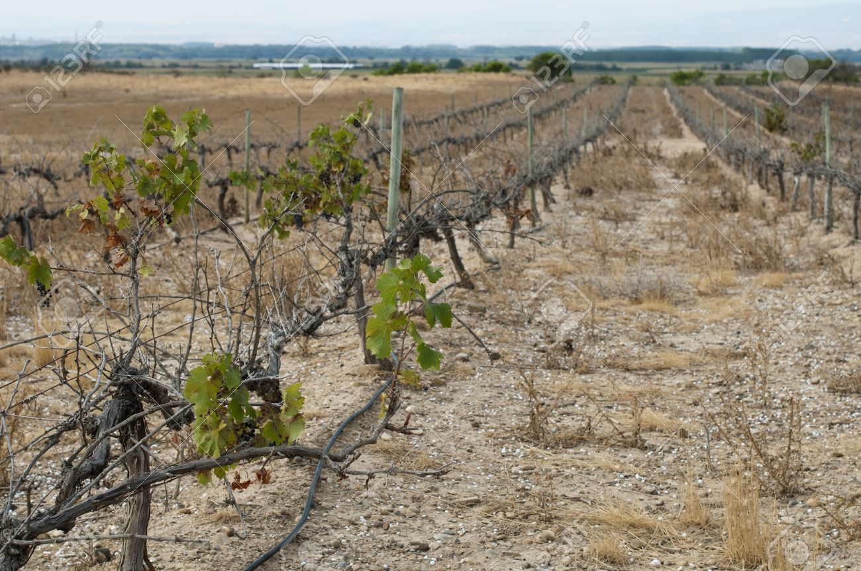

Slide 9
2. 40 or More Committed Team Disciples
A committed team disciple has made a “time, talent, treasure” commitment of at least 1 year. They are disciples and disciplemakers
Ideally a significant number are current active Christ followers and others join in from contacts who have been inactive.
The use of a “Launch Partnership Brochure” or similar helps to formalize a committed relationship.

Slide 10
Making a disciple…..!
Discern who is seeking by building trust
Engage them in purposeful gospel conversation
Invite them to take a new step of faith
Deepen their walk & commitment to Jesus trust>>>curious>>>open>>>seeking>>>following
INVEST & INVITE

Slide 11



Slide 12

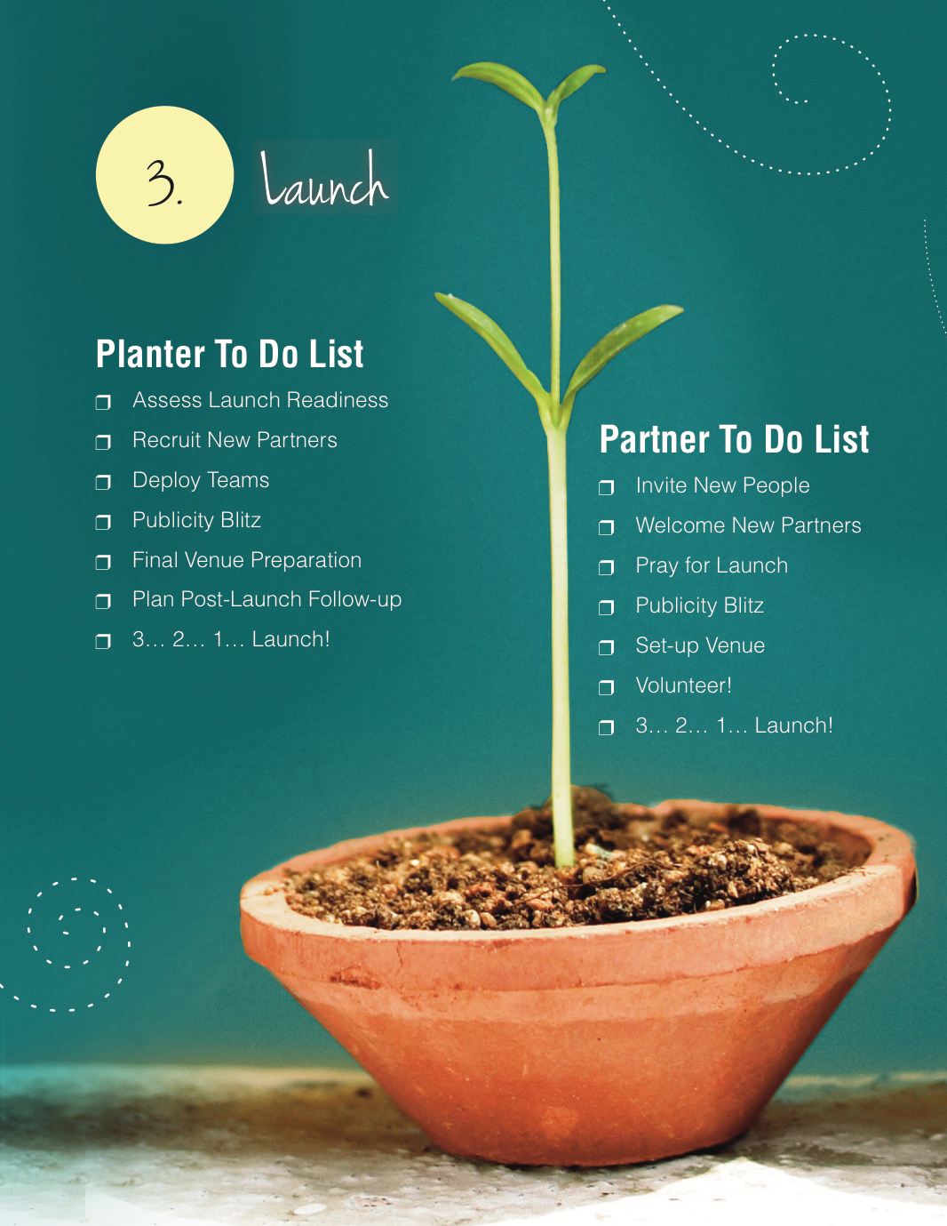

Slide 13

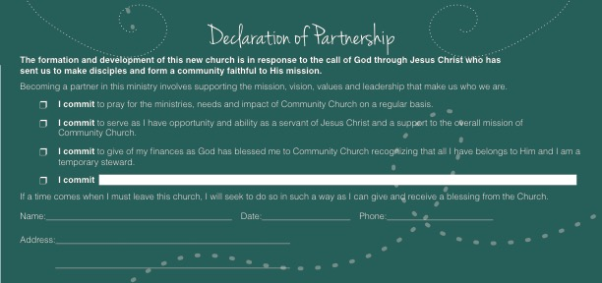

Slide 14
3. 7 or More Key Leaders
Hospitality…responsible for the guest experience “street to seat”.
Technology…responsible for sound, lights, projection.
Children…responsible to staff infant, toddler and elementary program
Worship…responsible to recruit, rehearse at team and lead worship
Logistics…responsible for set up and tear down.
Treasurer…responsible for collection, counting, controlling and reports
Social Media…responsible for ongoing promotion and communications.

Slide 15
4. 4 or More Small Groups
Simple, reproducible “affinity” model, long term and easy to replicate. Groups are the basic building blocks of a start up.
Each group has about 10-15people. Three practices: relational &social, discipleship & study, care & prayer. Sticky sermon strategy.
Each group has a leader who is mentored and coached by planter.
Groups become the “go to” place before launch and the “come back” event after launch.

Slide 16
5. 3 or More Preview Services
Preview services begin when metric progress has reached 80%
Preview services should build in attendance momentum
Preview services should be promoted “word of mouth”.
Preview services should be evaluated for improvements.

Slide 17
SECONDARY ELEMENTS OF A LARGE LAUNCH
Ideally your location is not a church building.
Ideally your launch is not before mid September or after January.
Ideally your launch involves mass marketing touching 5,000 homes plus your 1000 contacts and the invites of your 40 team.
Ideally your launch is a season/month, not just a Sunday.
Ideally your launch features a special guest/event every weekend. .

Slide 18
WILL THEY COME BACK TO HEAR YOU TEACH?
Preacher voice……………………………………………….….Conversational
Insider language………………………………………….. Outsider language
Therapeutic moralistic deism……………….. Transformational Jesus
Bible scholar……………………………………………………….Spiritual guide
Tell them everything……………………….. Leave them wanting more
Reporting the facts……………..… Authentic passionate experience
Who you listen to is who you become.

