Slide 1
PEOPLE MOMENTUM:
FIVE ESSENTIAL GROUPS TO DEVELOP

Slide 2
The Jesus way….
He was always moving gaining exposure to new people. Matt 9:35
He was recognized that people respond differently. Matt 13:3
He did not linger where there was not interest. Matt 10:14

Slide 3
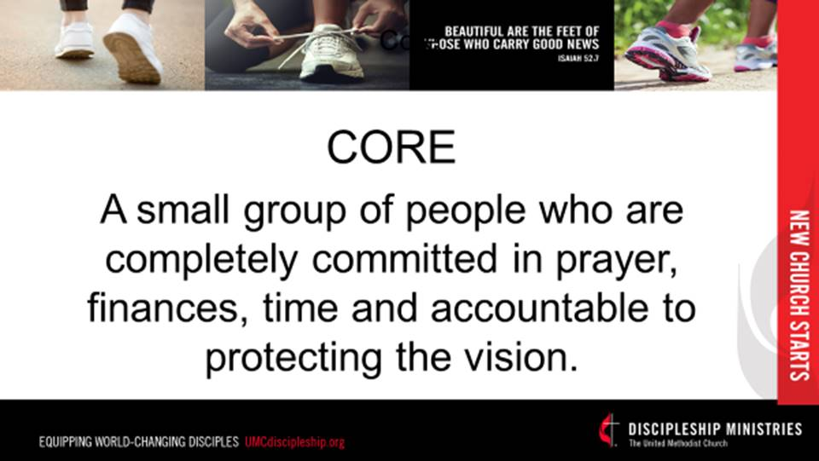

Slide 4
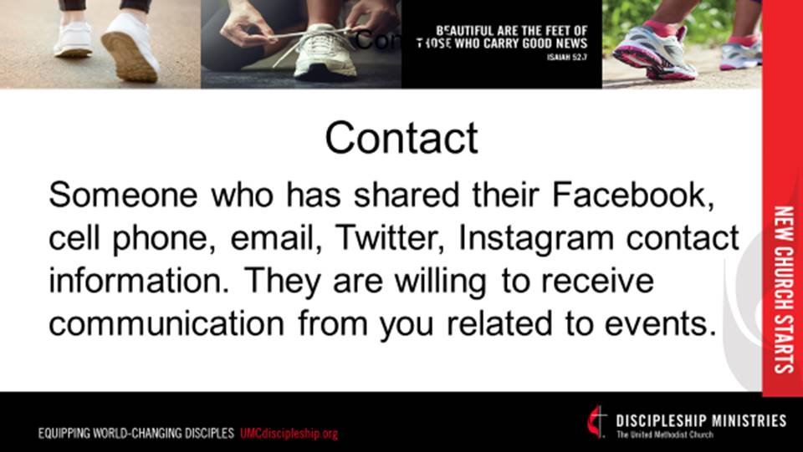

Slide 5
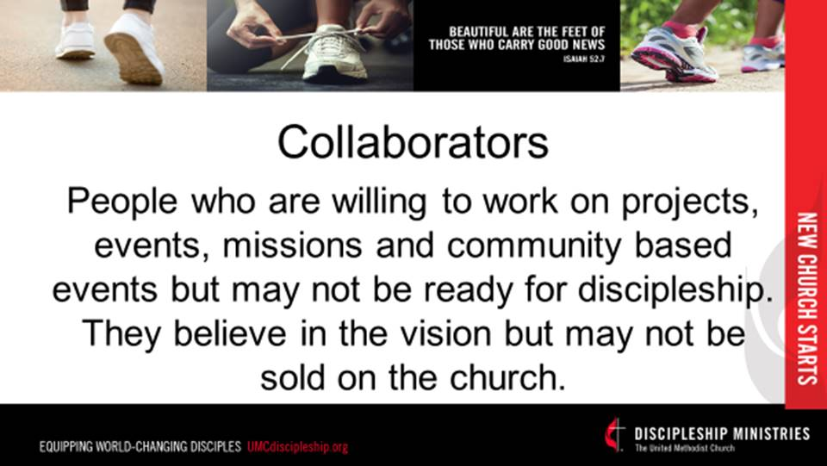

Slide 6
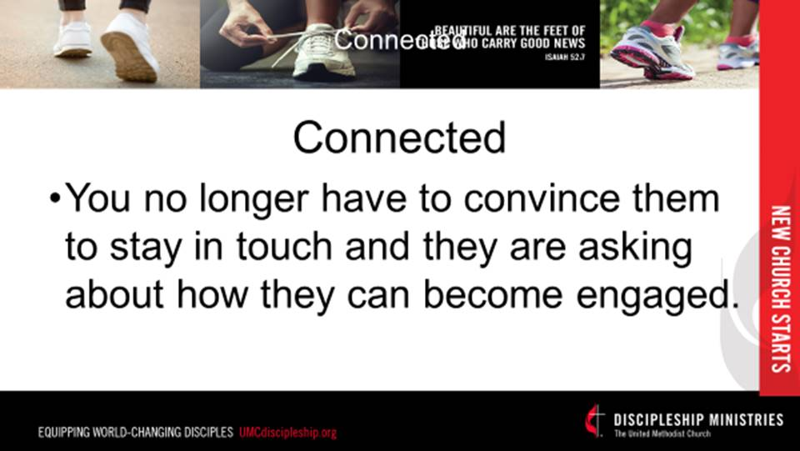

Slide 7
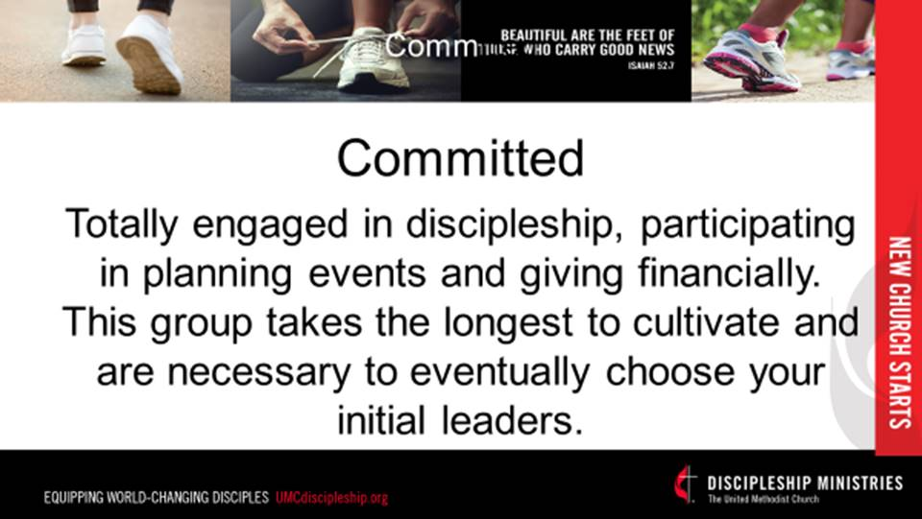

Slide 8
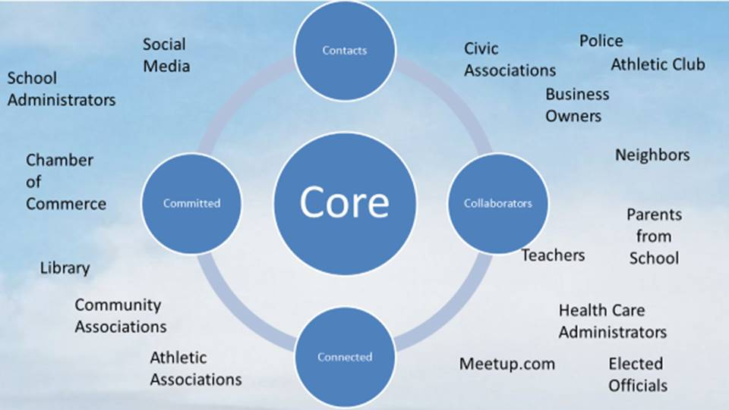

Slide 9
ESSENTIAL TOOL:
Data management software
1. Breeze
2.

Slide 10
STORYBOARD ELEMENTS:
WHO ARE YOU?
WHAT IS THE OPPORTUNITY?
WHAT IS THE VISION?
WHY IS THIS NEEDED?
WHY ME?
WHAT IS THE PLAN?
WHAT IS THE “ASK”?

Slide 11






