Slide 1
MISSIONAL DEMOGRAPHICS

Slide 2
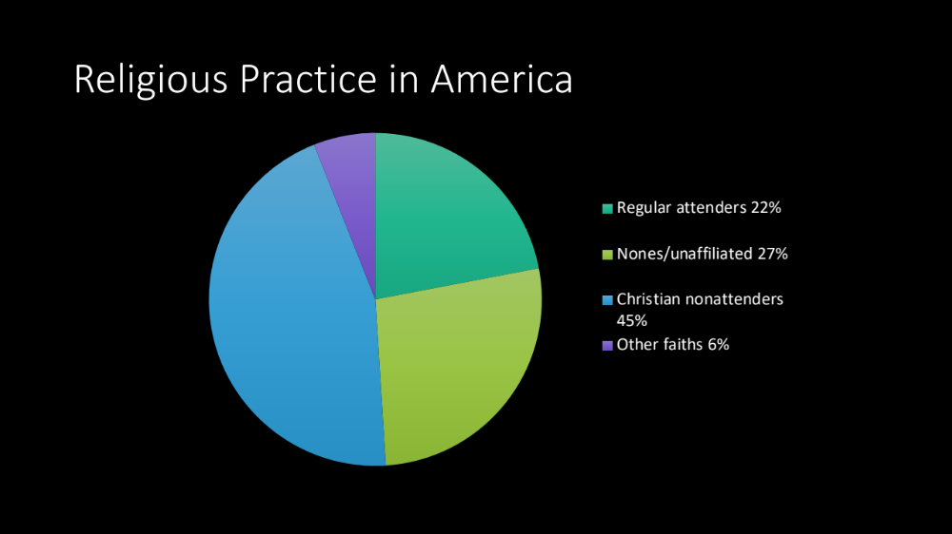

Slide 3
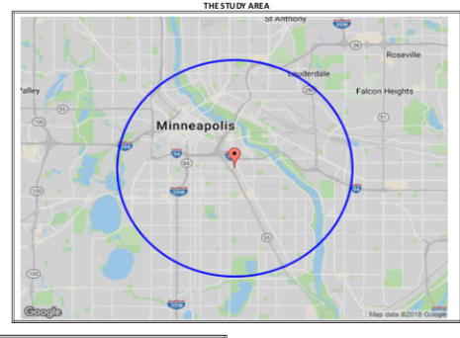
Do you have the right M. I. report?

Slide 4
Do you have the right M.I. report?
IF YOUR STUDY AREA IS TOO BROAD…..you cannot be all things to all
M. I. IS BEST WHEN IT HELPS YOU FOCUS YOUR MISSION….
IT IS ALWAYS WISE TO VALIDATE A DEMOGRAPHIC STUDY.

Slide 5
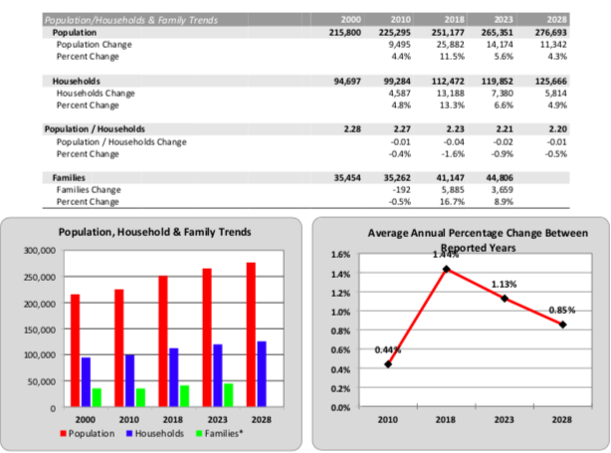

Slide 6
What does general population growth indicate?
THE 1 to 1000 RATIO
PLANTING IN ANTICIPATION OF GROWTH
TRENDS

Slide 7
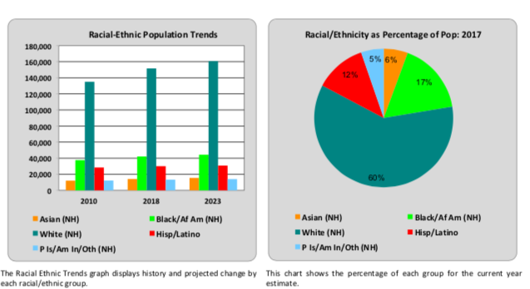

Slide 8
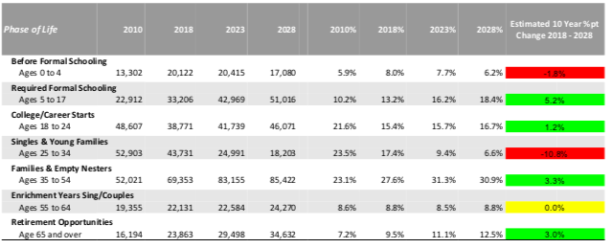

Slide 9
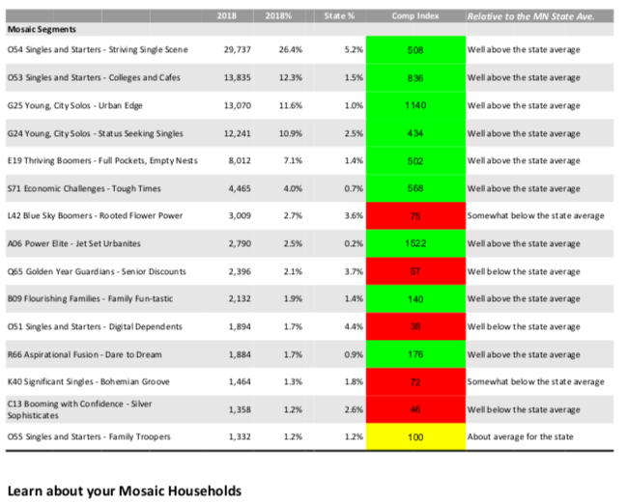

Slide 10
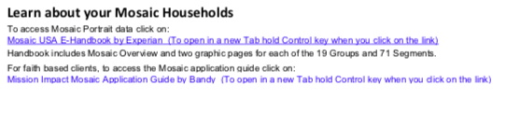
What do the lifestyle segments indicate?
LOOK FOR SEGMENTS 10% or GREATER
CAN YOUR SEGMENTS BE CLUSTERED UNDER ALPHABET?
WHAT CAN THE MISSION IMPACT GUIDE TELL YOU?
HOW DOES THIS INFORM YOUR START UP APPROACH?

Slide 11
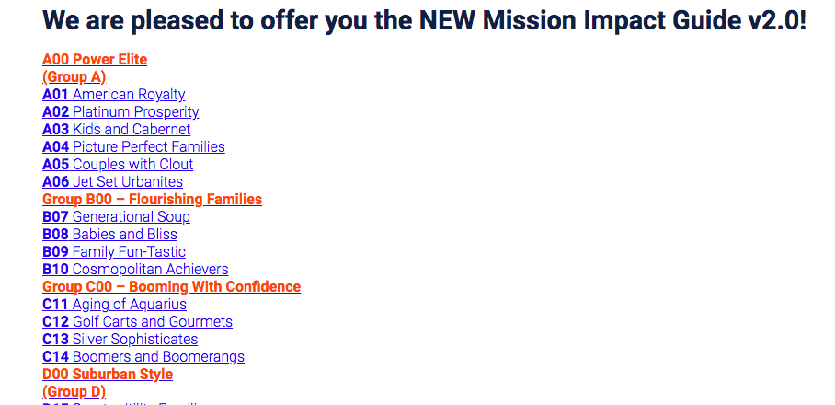

Slide 12
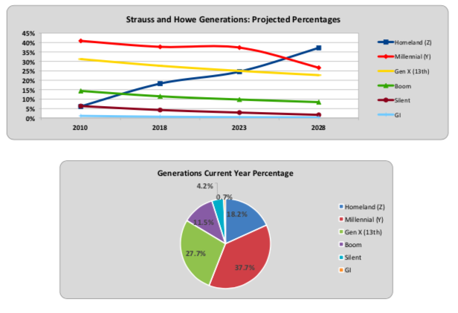
GENERATIONAL VARIABLES

Slide 13
IMPRESSIONS CATEGORIES: Community Mood
Drive for affluence
Devotion to family
Commitment to career
Concern for environment
Practice of altruism
Importance of faith
Entertainment
Desire to broaden horizons
Pursuit of personal growth
Sense of wellbeing

Slide 14
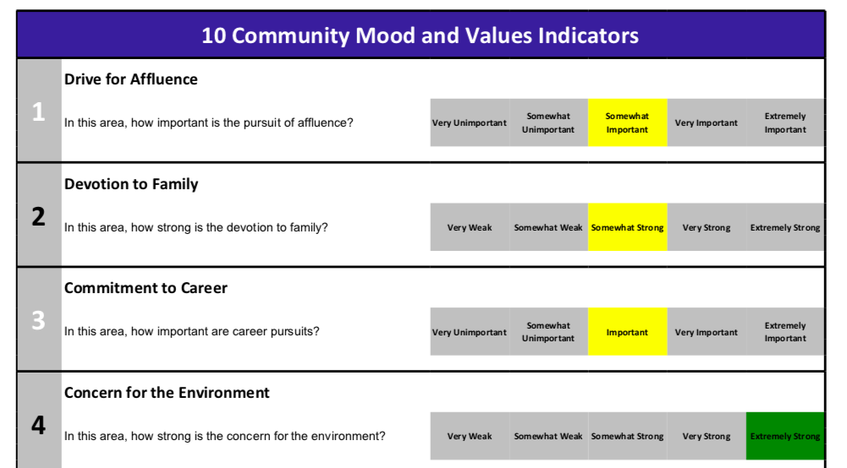
Mission Insite IMPRESSIONS

Slide 15
HOW DOES M.I. HELP WITH YOUR STORYBOARD?
REFINE YOUR AWARENESS OF THE UNDERSERVED PEOPLE GROUP.
GAIN INSIGHT INTO THE NEED AND OPPORTUNITY.
POSSIBLY GET CLAIRITY ON THE “ASK”

