Slide 1
DESIGN THINKING:
How will you attempt this difficult task?

Slide 2
DESIGN THINKING TAKES THE PRESSURE OFF
IT IS NOT ABOUT KNOWING IT ALL BEFORE YOU START
IT IS ABOUT TAKING ACTION IN ORDER TO LEARN
IT COMES OUT OF BUSINESS & MISSIOLOGY
DESIGN THINKING HELPS US MANAGE THE RISK ASSOCIATED WITH OUR ASSUMPTIONS.

Slide 3
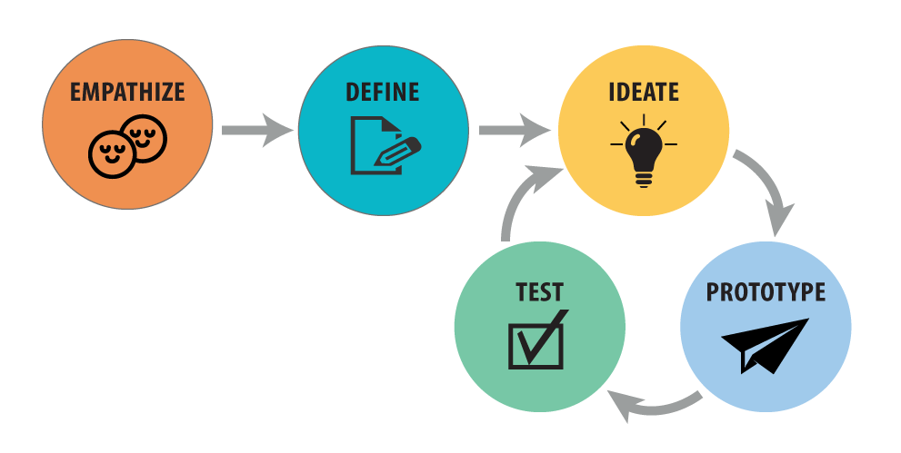
EMPATHIZE DEFINE IDEATE PROTOTYPE TEST REPEAT
Non judgmental Pain Priority Simple Feedback
Listen closely Challenge Possible Fail fast Short
Shadow client Clarify Idea Involve client Learning
Seek Objective Dream First iteration See impediments

Slide 4
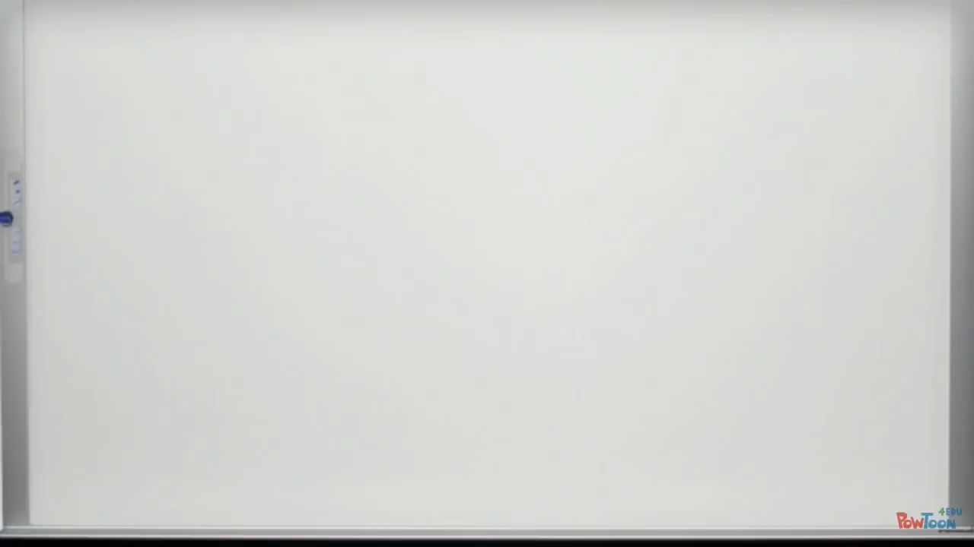

Slide 5
APPLYING DESIGN THINKING TO START UP:
THE PRIORITY OF CURIOSITY, OBSERVATION AND LISTENING.
THE IMPORTANCE OF TESTING ASSUMPTIONS AND REFINING.
STAYING NIMBLE AND ABLE TO PIVOT or FAIL FAST WHEN NEED BE.
STAYING ATTUNED TO THE SPIRIT AND ACTIVE IN PRAYER.

Slide 6
YOUR STORYBOARD PROJECT:
Messaging your vision to a potential donor.

Slide 7
STORYBOARD ELEMENTS:
WHO ARE YOU?
WHAT IS THE OPPORTUNITY?
WHAT IS THE VISION?
WHY IS THIS NEEDED?
WHY ME?
WHAT IS THE PLAN?
WHAT IS THE “ASK”?

Slide 8

WHO ARE YOU?
Identity
Affiliation

Slide 9
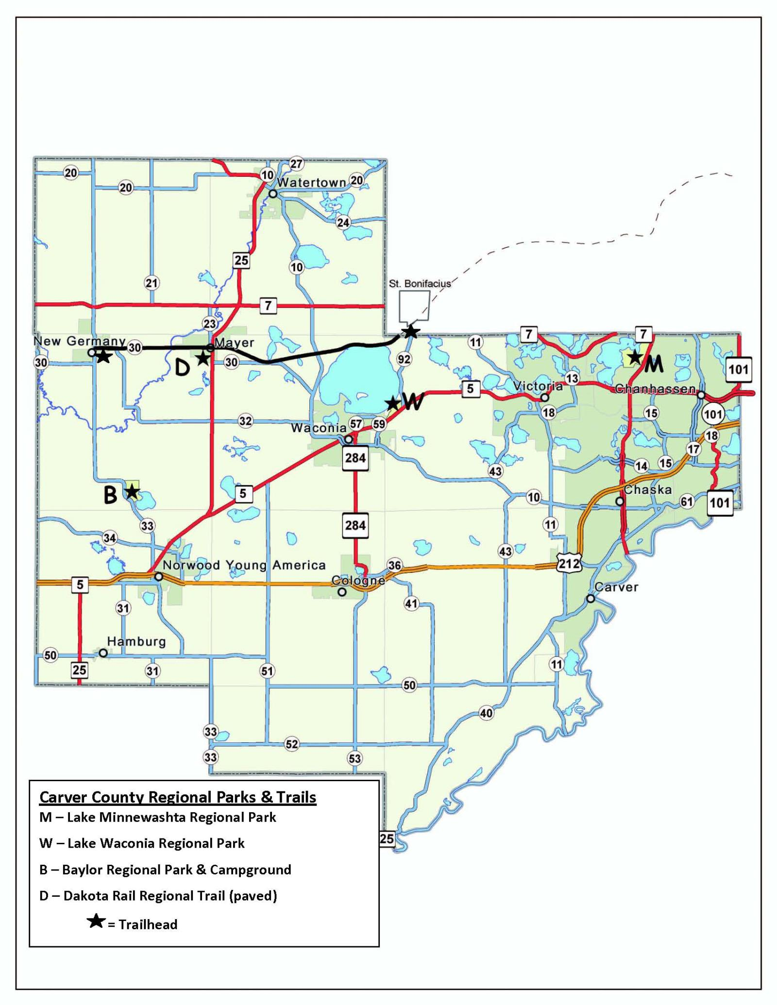
WHAT IS THE OPPORTUNITY?
Fastest growing county in
Minnesota.
High percentage of young
families.
Vision of Annual Conference

Slide 10
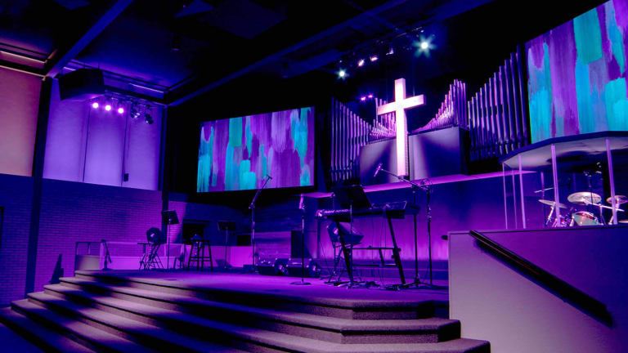
WHAT IS THE VISION?
Relevant
Guest oriented
Band led
Socially engaged
New Jesus community

Slide 11


WHY IS THIS NEEDED?
Interview insights
Partners waiting
Area underserved

Slide 12
WHY AM I/ARE WE LEADING THIS?
Calling
Discernment
Confirmation

Slide 13

WHAT IS THE PLAN?
Pre-launch for 9-12 months
Pre-views for 1-2 months
Launch month
Develop 3-5 years.

Slide 14

WHAT IS THE ASK?
Will you pray?
Will you give?
Will you serve?

Slide 15
STORYBOARD PROJECT:
WHO ARE YOU?
WHAT IS THE OPPORTUNITY?
WHAT IS THE VISION?
WHY IS THIS NEEDED?
WHY ME?
WHAT IS THE PLAN?
WHAT IS THE “ASK”?

