Slide 1

LEADING CHANGE

Slide 2
CHANGING FROM…
CHURCH IS FOR US
PASTOR IS TO SHEPHERD
ACCOUNTABLE TO PEOPLE
SAFETY OF STATUS QUO
CHURCH IS FOR THEM & us
PASTOR TO LEAD & shepherd
ACCOUNTABLE TO MISSION
SAFE PLACE IS NOT SAFE

Slide 3
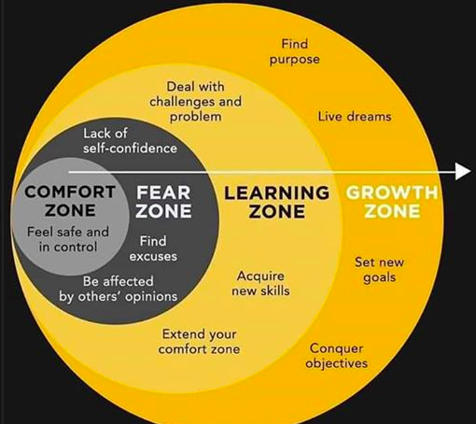
WHY IS THIS SO HARD?

Slide 4
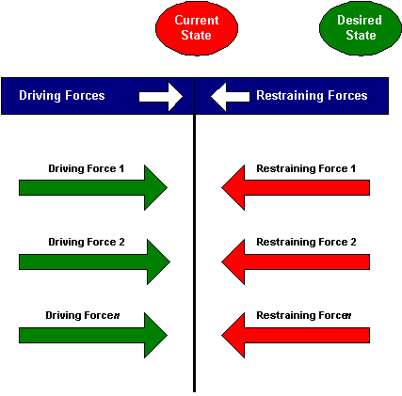
Force Field Analysis…..

Slide 5

1. LEADING CHANGE: Build Trust
Nothing moves faster….
than the speed of trust.

Slide 6
Trust Builders
Practice total transparency
Confront reality in yourself & circumstances.
Clarify expectations of all parties.
Demonstrate accountability.
Listening before speaking.
Keeping your commitments entirely.
Focus on results not just activity.
Right whatever wrongs you must.
Humbly seek improvement and show it.
Be loyal to your commitments.

Slide 7
2. LEADING CHANGE: Clarify Values
Multiplying ministry is less
about mechanics and more about
values.

Slide 8
What values will define this ministry?
treasured traditions
popular trends
God’s Mission
personal preferences
valued relationships

Slide 9
Multiplication Values
Compassion for the unchurched
Culturally relevant style
Great Commission orientation
Developing and releasing leaders
Confidence in God’s ability
Kingdom perspective
Generosity

Slide 10
3. LEADING CHANGE: Develop a
“Lead Team”
Highly respected in the church.
Informal leaders…well known.
Supportive of your vision though may not actually participate.
Willing for their names to be shared.

Slide 11
4. LEADING CHANGE: Communicate Process
Multiplication of ministry is more
momentum than calendar driven.

Slide 12
New Service/Site Process
LAUNCH MONTH CELEBRATION
BROAD MARKET PROMOTION 1000’s
2-4 “soft” PREVIEW SERVICES 2-4
LAUNCH TEAM 40+ PEOPLE 40
FORM SMALL GROUPS 3-4
MISSION ENGAGEMENT 1000
KEY TEAM TRAINING
STRAT PLAN/PRAY 100
ORG CHANGE
PASTOR

Slide 13
4. LEADING CHANGE: Calm Style
Whenever a leader decides to risk wise change,
anxiety shows up to choke it to death.

Slide 14

²² The seed falling among the thorns refers to someone who hears the word, but the worries of this life and the deceitfulness of wealth choke the word, making it unfruitful.

Slide 15
Sabotage Solutions:
Stay calm and clear.
Clarify Values.
Develop an internal “LEAD TEAM” of supporters.
Structure accountability to external Stake Holders

Slide 16
LEADING CHANGE REQUIRES….

